Slide 1
UNIT I
Financial Management

Slide 2
Course Outcomes
Appraise the concept of financial management and scope of financial management.
Analysis financial goal profit maximization vs wealth maximization.

Slide 3
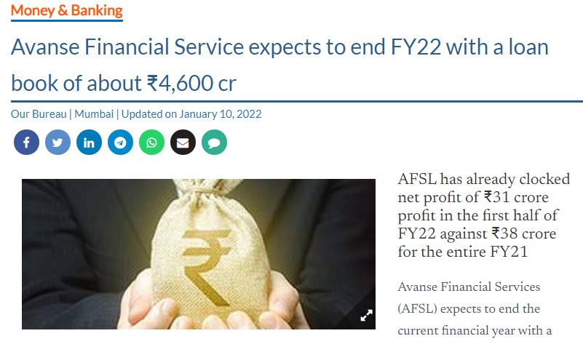
News Analysis
https://www.thehindubusinessline.com/money-and-banking/avanse-financial-service-expects-to-end-fy22-with-a-loan-book-of-about-4600-cr/article38213576.ece

Slide 4
Definition of Financial Management
“Financial management is the activity concerned with planning, raising, controlling and administering of funds used in the business.” – Guthman and Dougal
“Financial management is the operational activity of a business that is responsible for obtaining and effectively utilizing the funds necessary for efficient operations.”- Massie

Slide 5
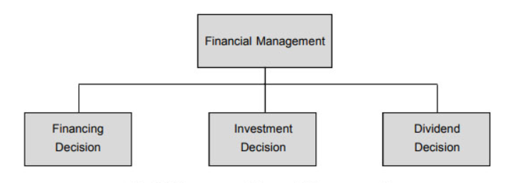
Scope of Financial Management

Slide 6
Financing Decisions
Broadly, financing decisions concerned when, where from and how to acquire funds to meet the firm’s investment needs. The central issue is to determine the appropriate proportion of equity and debt. The mix of debt and equity is known as the firm’s capital structure. The firm’s capital structure is considered optimum when the market value of shares is maximized.

Slide 7
Investment Decision
A firm’s investment decisions involve capital expenditures. They are, therefore, referred as capital budgeting decisions. Two important aspects of investment decisions are
the evaluation of the prospective profitability of new investments
the measurement of a cut-off rate against which the prospective return of new investments could be compared.

Slide 8
Dividend Decisions
Dividend decision concerned with, whether the firm should distribute all profits, or retain them, or distribute a portion and retain the balance. The proportion of profits distributed as dividends is called the dividend-payout ratio and the retained portion of profits is known as the retention ratio.
Like the debt policy, the dividend policy should be determined in terms of its impact on the shareholders’ value. The optimum dividend policy is one that maximizes the market value of the firm’s shares.

Slide 9
MCQs
Que. 1 Financial management is primarily concerned with……………..
All aspects of acquiring of funds and utilization of financial resources for firm activities.
Arrangements of funds
Efficient management of every business
Profit maximization

Slide 10
Answer: Option A
Financial Management is mainly concerned with all aspects of acquiring and utilizing financial resources for firms activities. Financial Management is the application of general principles of management to the financial possessions of an enterprise.

Slide 11
Functions of Financial Management
Estimation of capital requirements
Determination of capital composition
Investment of funds
Disposal of surplus
Management of cash
Financial controls

Slide 12
Goals of Financial Management
Profit Maximisation
Wealth Maximisation

Slide 13
Profit Maximization
Profit Maximization is the capability of the firm in producing maximum output with the limited input, or it uses minimum input for producing stated output. It is essential for the success, survival, and growth of the company. Profit is a long term objective, but it has a short-term perspective i.e. one financial year.

Slide 14
Wealth Maximisation
Wealth maximization is the ability of a company to increase the market value of its common stock over time. The market value of the firm is based on many factors like their goodwill, sales, services, quality of products, etc. This will help the firm to increase their share in the market, attain leadership, maintain consumer satisfaction and many other benefits are also there.

Slide 15
Wealth maximisation Vs Profit Maximisation
BASIS FOR COMPARISON | PROFIT MAXIMIZATION | WEALTH MAXIMIZATION
Concept | The main objective of a concern is to earn a larger amount of profit. | The ultimate goal of the concern is to improve the market value of its shares.
Emphasizes on | Achieving short term objectives. | Achieving long term objectives.
Consideration of Risks and Uncertainty | No | Yes
Advantage | Acts as a yardstick for computing the operational efficiency of the entity. | Gaining a large market share.
Recognition of Time Pattern of Returns | No | Yes

Slide 16
MCQ
Que2. The primary goal of financial management is………
To maximize the return
To minimize the return
To maximize the wealth of owners
To maximize profit

Slide 17
Answer: Option C
The primary goal of the financial management is to maximize the wealth of owners. All businesses aim to maximize their profits, minimize their expenses and maximize their market share.

Slide 18
Role of Finance Manager
Raising of Funds
Allocation of Funds
Profit Planning
Understanding Capital Markets

Slide 19
Objectives of Financial Management
To ensure regular and adequate supply of funds to the concern.
To ensure adequate returns to the shareholders.
To ensure optimum funds utilization.
To ensure safety on investment.
To plan a sound capital structure.

Slide 20
MCQ
Que3. In his traditional role the finance manager is responsible for…………….
Proper utilization of funds
Arrangement of financial resources
Acquiring capital assets of the organization
Efficient management of capital

Slide 21
Answer: Option B
In his traditional role the finance manager is responsible for arrangement of financial resources. Financial managers are responsible for the financial health of an organization. They produce financial reports, direct investment activities, and develop strategies and plans for the long-term financial goals of their organization.

Slide 22
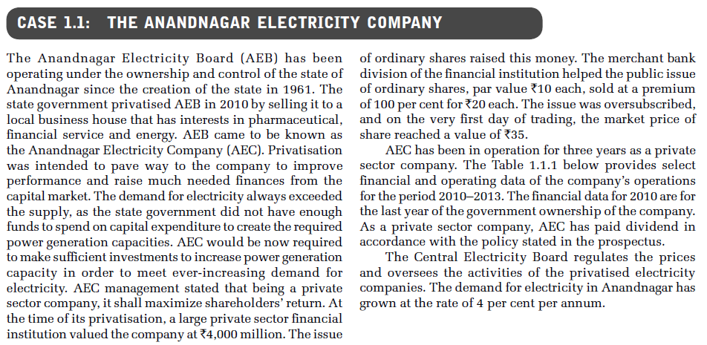

Slide 23
